Slide 1

TSQL Windows Functions
Photo by Dmitri Popov on Unsplash

Slide 2

Introductions – Syntax
Photo by rawpixel on Unsplash

Slide 3
Syntax
<WindowsFunction>( )
OVER (
[ <PARTITION BY clause> ]
[ <ORDER BY clause> ]
[ <ROW or RANGE clause> ]
)

Slide 4
Windows functions
RowNumber()
Sum()
Avg()
Max()
Min()
Rank()
DenseRank()
Ntile()

Slide 5

Enough boring stuff already
Photo by Martin Dufosset
on Unsplash
Notes:
Photo by Martin Dufosset on Unsplash

Slide 6

Lets
Some data
Photo by Andrew Neel on Unsplash
Notes:
Photo by Andrew Neel on Unsplash

Slide 7
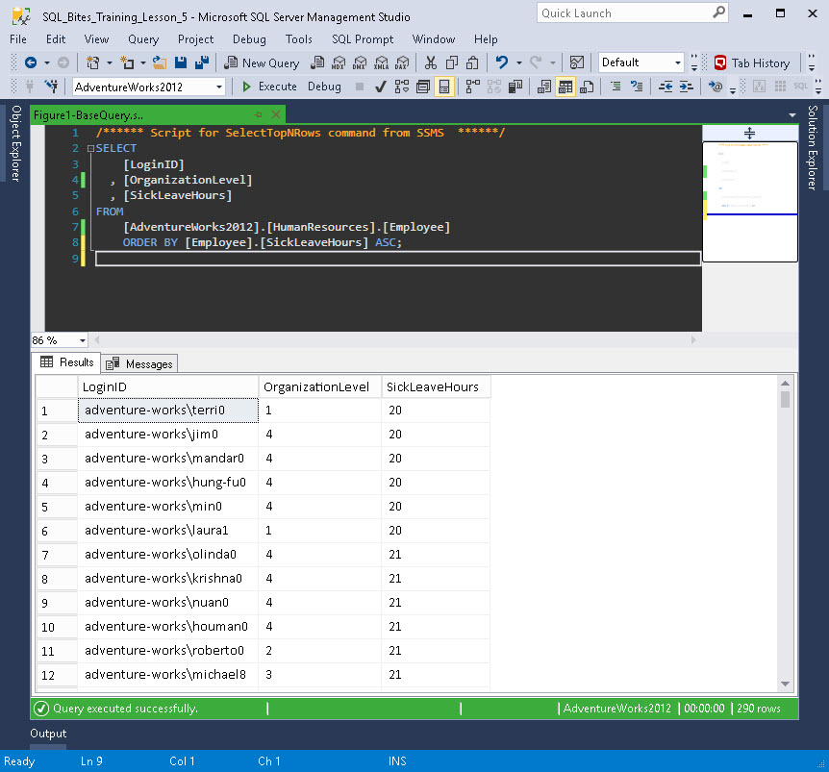
Figure 1 - List of all the employee's records ordered by [SickLeaveHours] in ascending order

Slide 8
BORING !!!!
Photo by Martin Dufosset
on Unsplash
Notes:
Photo by Martin Dufosset on Unsplash

Slide 9
Specification
For each organisational level order records with person with highest sick hours is given order number = 1, next highest sick hours is given order number 2. Each organisational will be ordered separately.
Example Dataset
Name | Organisational Level | Sick hours | Order
Joe Bloggs | 1 | 255 | 1
Mary Smith | 1 | 10 | 2
Robert Johnstone | 2 | 30 | 1
Mary Omartian | 2 | 29 | 2
Susan Feeney | 2 | 22 | 3
Karen Hadi | 3 | 21 | 4
Willam Player | 4 | 151 | 1
Steph Tringali | 4 | 60 | 2
Stephen Lietz | 4 | 2 | 3

Slide 10
The Query
USE [AdventureWorks2012];
SELECT
[Employee].[LoginID]
, [Employee].[OrganizationLevel]
, [Employee].[SickLeaveHours]
, ROW_NUMBER()
OVER (
PARTITION BY [Employee].[OrganizationLevel]
ORDER BY [Employee].[SickLeaveHours]
) AS [RowNumber]
FROM [HumanResources].[Employee];

Slide 11
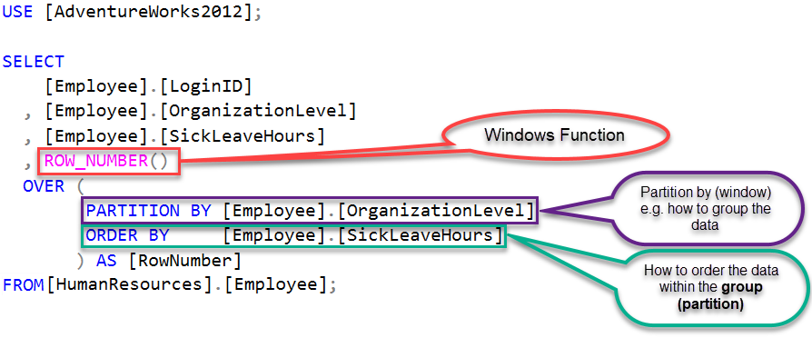

Slide 12
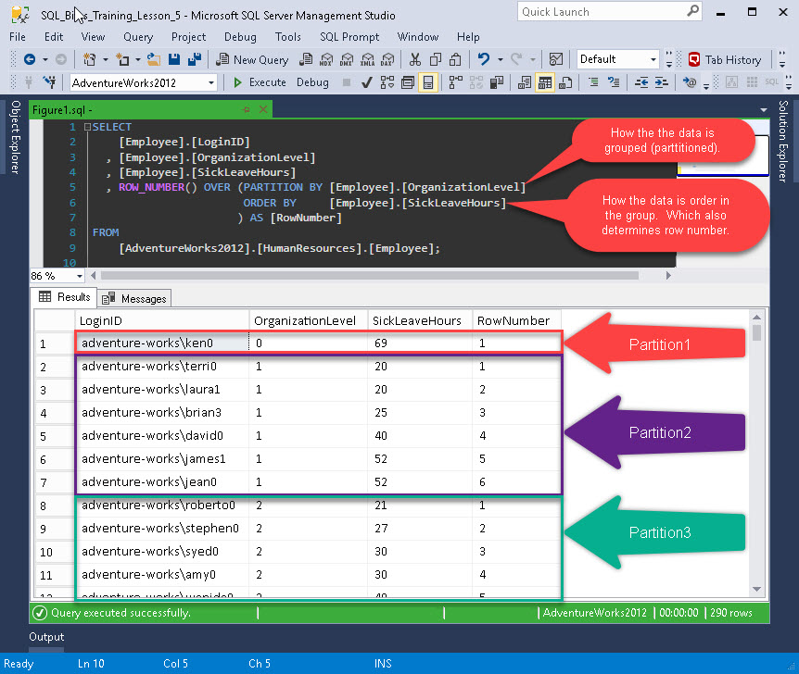
The dataset

Slide 13
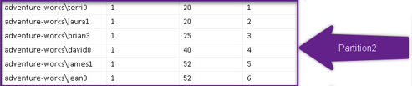
Partition by
Apply windows function to this group of data (in this case where[Employee].[OrganizationLevel] [Employee].[OrganizationLevel] = 1 )
Partition by = Group/set of data
OrganizationLevel
RowNumber

Slide 14

Could you not…..
Do that in Excel???
Photo by bruce mars on Unsplash
Notes:
Photo by bruce mars on Unsplash

Slide 15

Quick open a spreadsheet
Photo by rawpixel on Unsplash
Notes:
Photo by rawpixel on Unsplash

Slide 16


Slide 17
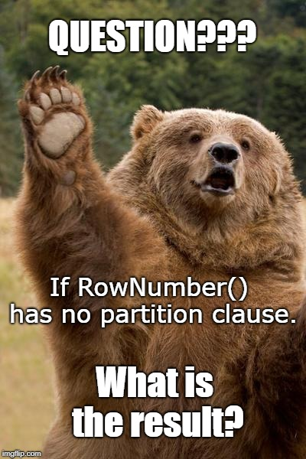

Slide 18
Rank() Function
Returns the rank of each row within the partition of a result set. The rank of a row is one plus the number of ranks that come before the row in question.
Blah blah blah blah?

Slide 19
The Query
USE [AdventureWorks2012];
SELECT
[Employee].[LoginID]
, [Employee].[OrganizationLevel]
, [Employee].[SickLeaveHours]
, RANK() OVER ( PARTITION BY [Employee].[OrganizationLevel]
ORDER BY [Employee].[SickLeaveHours]
) AS [Rank]
FROM [HumanResources].[Employee];
What’s this?
What’s this?
What’s this?

Slide 20
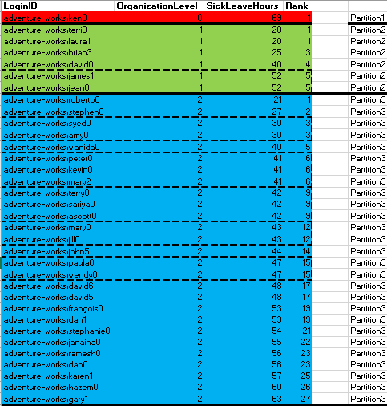
Dataset (colour coded)

Slide 21
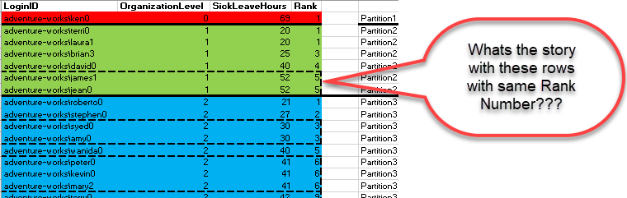
Where [Employee].[SickLeaveHours] are the same for one or more records. All those records in same partition will get same rank.

Slide 22
Other windows ranking functions
USE [AdventureWorks2012];
SELECT
[Employee].[LoginID]
, [Employee].[OrganizationLevel]
, [Employee].[SickLeaveHours]
, ROW_NUMBER() OVER (PARTITION BY [Employee].[OrganizationLevel]
ORDER BY [Employee].[SickLeaveHours]
) AS [RowNumber]
, RANK() OVER (PARTITION BY [Employee].[OrganizationLevel]
ORDER BY [Employee].[SickLeaveHours]
) AS [Rank]
, DENSE_RANK() OVER (PARTITION BY [Employee].[OrganizationLevel]
ORDER BY [Employee].[SickLeaveHours]
) AS [Dense_Rank]
, NTILE(4) OVER (PARTITION BY [Employee].[OrganizationLevel]
ORDER BY [Employee].[SickLeaveHours]
) AS [NTILE(4)]
FROM [HumanResources].[Employee]

Slide 23
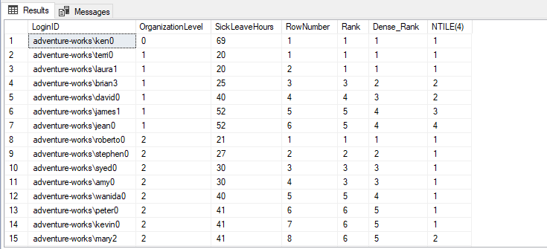
Results set from the query
(Can you spot the differences?)

Slide 24


Slide 25
Windows aggregate functions
SUM()
MAX()
MIN()
AVG()
COUNT()

Slide 26

It’s exciting !

Slide 27
SUM() function
Lets look at this query
SELECT
[Employee].[LoginID]
, [Employee].[OrganizationLevel]
, [Employee].[SickLeaveHours]
, SUM([Employee].[SickLeaveHours])
OVER (PARTITION BY [Employee].[OrganizationLevel]
) AS [SUM_SickLeaveHours]
, SUM([Employee].[SickLeaveHours])
OVER (PARTITION BY [Employee].[OrganizationLevel]
ORDER BY [Employee].[LoginID]
) AS [SUM_SickLeaveHours_With_Order]
FROM [AdventureWorks2012].[HumanResources].[Employee];

Slide 28
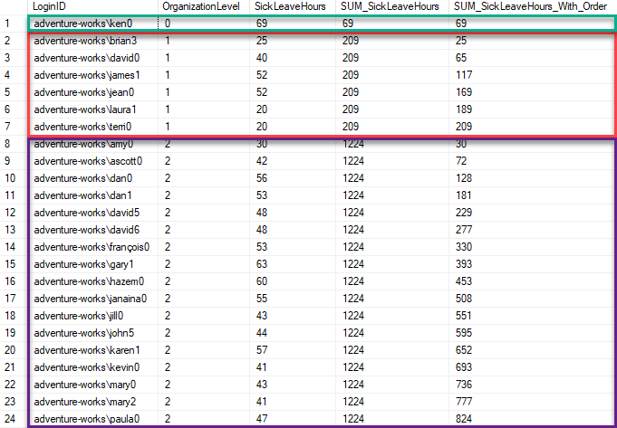
The dataset returned

Slide 29


Slide 30
Could you not…..
Do that in Excel???
Photo by bruce mars on Unsplash
Notes:
Photo by bruce mars on Unsplash

Slide 31
Quick open a spreadsheet
Photo by rawpixel on Unsplash
Notes:
Photo by rawpixel on Unsplash

Slide 32


Slide 34
Did you know?
SELECT [Employee].[LoginID]
, [Employee].[OrganizationLevel]
, [Employee].[SickLeaveHours]
, CAST([Employee].[SickLeaveHours] AS DECIMAL(6, 2))
/ CAST(SUM([Employee].[SickLeaveHours])
OVER (PARTITION BY [Employee].[OrganizationLevel]) AS DECIMAL(6, 2))
* 100 AS [PercentageOfTotalOverPartition]
FROM [AdventureWorks2012].[HumanResources].[Employee];
(you can use windows functions in calculations)

Slide 35
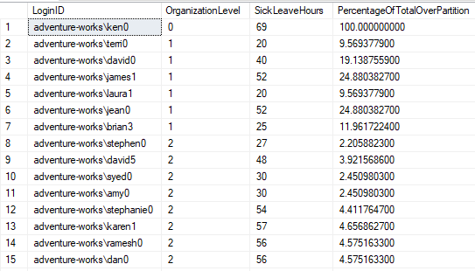
Dataset generated
, CAST([Employee].[SickLeaveHours] AS DECIMAL(6, 2))
/ CAST(SUM([Employee].[SickLeaveHours]) OVER (PARTITION BY [Employee].[OrganizationLevel]) AS DECIMAL(6, 2))
* 100 AS [PercentageOfTotalOverPartition]

Slide 36
Next up
LEAD()
LAG()

Slide 37
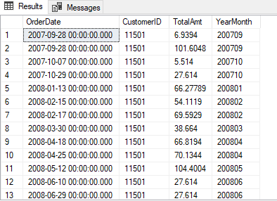
Lets generate list of orders for a customer
SELECT TOP 100 PERCENT
[SalesOrderHeader].[OrderDate]
, [SalesOrderHeader].[CustomerID]
, [SalesOrderHeader].[TotalAmt]
/*cast the date to a suitable format to allow sorting*/
, CAST(FORMAT([SalesOrderHeader].[OrderDate], 'yyyy') + FORMAT([SalesOrderHeader].[OrderDate], 'MM') AS NVARCHAR(6)) AS [YearMonth]
FROM [AdventureWorks2012].[Sales].[SalesOrderHeader]
WHERE [SalesOrderHeader].[CustomerID] = 11501
ORDER BY [SalesOrderHeader].[OrderDate]

Slide 38
Use a group by and CTE to look at the summarized data
WITH [Step1]
AS
(
SELECT TOP 100 PERCENT
[SalesOrderHeader].[OrderDate]
, [SalesOrderHeader].[CustomerID]
, [SalesOrderHeader].[TotalAmt]
/*cast the date to a suitable format to allow sorting*/
, CAST(FORMAT([SalesOrderHeader].[OrderDate], 'yyyy’)
+ FORMAT([SalesOrderHeader].[OrderDate], 'MM') AS NVARCHAR(6)) AS [YearMonth]
FROM [AdventureWorks2012].[Sales].[SalesOrderHeader]
WHERE [SalesOrderHeader].[CustomerID] = 11501
ORDER BY [SalesOrderHeader].[OrderDate]
)
, [Step2] AS
(
SELECT [Step1].[CustomerID]
, [Step1].[YearMonth]
, SUM([Step1].[TotalAmt]) AS [Monthly_Total]
FROM [Step1]
GROUP BY
[Step1].[CustomerID]
, [Step1].[YearMonth]
)
SELECT
[Step2].[CustomerID]
, [Step2].[YearMonth]
, [Step2].[Monthly_Total]
, LEAD ([Step2].[Monthly_Total]) OVER (ORDER BY [Step2].[YearMonth]) AS [LeadValue]
, LAG ([Step2].[Monthly_Total]) OVER (ORDER BY [Step2].[YearMonth]) AS [LagValue]
FROM [Step2]

Slide 39
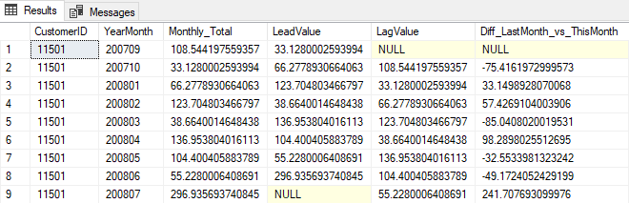
The results set
Lets look at it in more detail

Slide 40
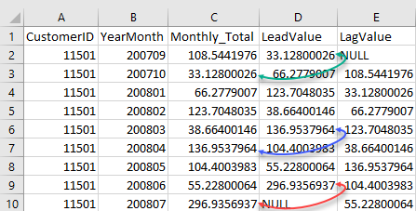
LEAD() Function
LEAD ([Step2].[Monthly_Total]) OVER (ORDER BY [Step2].[YearMonth]) AS [LeadValue]
The lead function (by default) returns the value from the next record. As can be seen in the figure below.

Slide 41
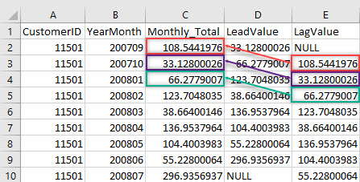
LAG() Function
LAG ([Step2].[Monthly_Total]) OVER (ORDER BY [Step2].[YearMonth]) AS [LagValue]
The lag function (by default) returns the value from the previous record. As can be seen in the figure below.

Slide 42


Slide 43

Can Lead() and Lag()
be used in calculation’s?

Slide 44
Yes they can !
(this is the last part of the CTE from the previous query with one extra line)
SELECT
[Step2].[CustomerID]
, [Step2].[YearMonth]
, [Step2].[Monthly_Total]
, LEAD([Step2].[Monthly_Total]) OVER (ORDER BY [Step2].[YearMonth]) AS [LeadValue]
, LAG([Step2].[Monthly_Total]) OVER (ORDER BY [Step2].[YearMonth]) AS [LagValue]
, [Step2].[Monthly_Total] -
LAG([Step2].[Monthly_Total]) OVER (ORDER BY [Step2].[YearMonth]) AS [Diff_LastMonth_vs_ThisMonth]
FROM [Step2]
Lets look at the result set

Slide 45
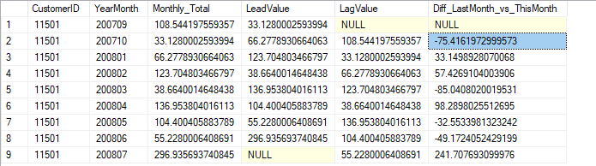
Results set
Lets look at row 2 in more detail

Slide 46
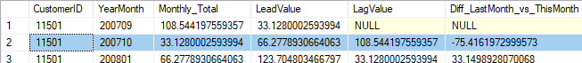
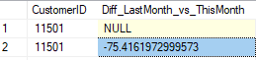
Row 2
Value in Diff_LastMonth_vs_ThisMonth get from this line
[Step2].[Monthly_Total] - LAG([Step2].[Monthly_Total]) OVER (ORDER BY [Step2].[YearMonth]) AS [Diff_LastMonth_vs_ThisMonth]
Calculation for line 2
[Step2].[Monthly_Total] - LAG([Step2].[Monthly_Total]) OVER (ORDER BY [Step2].[YearMonth]) AS [Diff_LastMonth_vs_ThisMonth]
33.1280002593994 - 108.544197559357 = -75.4161972999576 AS [Diff_LastMonth_vs_ThisMonth]

Slide 47


Slide 48
Lets do this
USE AdventureWorks2012;
WITH [Step1]
AS (
SELECT TOP 100 PERCENT
[SalesOrderHeader].[OrderDate]
, [SalesOrderHeader].[CustomerID]
, [SalesOrderHeader].[TotalAmt]
/*cast the date to a suitable format to allow sorting*/
, CAST(FORMAT([SalesOrderHeader].[OrderDate], 'yyyy')
+ FORMAT([SalesOrderHeader].[OrderDate], 'MM') AS NVARCHAR(6)) AS [YearMonth]
FROM [AdventureWorks2012].[Sales].[SalesOrderHeader]
--WHERE [SalesOrderHeader].[CustomerID] = 11501
ORDER BY [SalesOrderHeader].[OrderDate]
) , [Step2] AS
( SELECT
[Step1].[CustomerID]
, [Step1].[YearMonth]
, SUM([Step1].[TotalAmt]) AS [Monthly_Total]
FROM [Step1]
GROUP BY [Step1].[CustomerID], [Step1].[YearMonth]
)
SELECT
[Step2].[CustomerID]
, [Step2].[YearMonth]
, [Step2].[Monthly_Total]
, LEAD([Step2].[Monthly_Total]) OVER(PARTITION BY [Step2].[CustomerID] ORDER BY [Step2].[YearMonth]) AS [LeadValue]
, LAG([Step2].[Monthly_Total]) OVER(PARTITION BY [Step2].[CustomerID] ORDER BY [Step2].[YearMonth]) AS [LagValue]
, [Step2].[Monthly_Total] - LAG([Step2].[Monthly_Total]) OVER (
PARTITION BY [Step2].[CustomerID] ORDER BY [Step2].[YearMonth])
AS [Diff_LastMonth_vs_ThisMonth]
FROM [Step2]

Slide 49

What is different???
1) Removed the WHERE clause
Now we get all the customer records ☺
2) Add PARTITION BY to the OVER Clauses

Slide 50
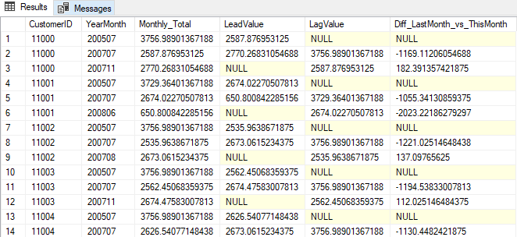
The results set
(yeah ok a bit ‘Meh’)

Slide 51
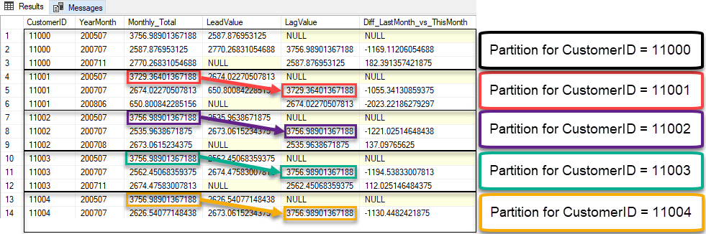
Annotated results set

Slide 52

…and yes there's much more

Slide 53
Next up
First_Value()
Last_Value()

Slide 54
A familiar friend ☺
Let’s do some surgery on it!!!!
WITH [Step1]
AS
(
SELECT TOP 100 PERCENT
[SalesOrderHeader].[OrderDate]
, [SalesOrderHeader].[CustomerID]
, [SalesOrderHeader].[TotalAmt]
/*cast the date to a suitable format to allow sorting*/
, CAST(FORMAT([SalesOrderHeader].[OrderDate], 'yyyy’)
+ FORMAT([SalesOrderHeader].[OrderDate], 'MM') AS NVARCHAR(6)) AS [YearMonth]
FROM [AdventureWorks2012].[Sales].[SalesOrderHeader]
WHERE [SalesOrderHeader].[CustomerID] = 11501
ORDER BY [SalesOrderHeader].[OrderDate]
)
, [Step2] AS
(
SELECT [Step1].[CustomerID]
, [Step1].[YearMonth]
, SUM([Step1].[TotalAmt]) AS [Monthly_Total]
FROM [Step1]
GROUP BY
[Step1].[CustomerID]
, [Step1].[YearMonth]
)
SELECT
[Step2].[CustomerID]
, [Step2].[YearMonth]
, [Step2].[Monthly_Total]
, LEAD ([Step2].[Monthly_Total]) OVER (ORDER BY [Step2].[YearMonth]) AS [LeadValue]
, LAG ([Step2].[Monthly_Total]) OVER (ORDER BY [Step2].[YearMonth]) AS [LagValue]
FROM [Step2]

Slide 55
A little change at the end
WITH [Step1]
AS
(
SELECT TOP 100 PERCENT
[SalesOrderHeader].[OrderDate]
, [SalesOrderHeader].[CustomerID]
, [SalesOrderHeader].[TotalAmt]
/*cast the date to a suitable format to allow sorting*/
, CAST(FORMAT([SalesOrderHeader].[OrderDate], 'yyyy') + FORMAT([SalesOrderHeader].[OrderDate], 'MM') AS NVARCHAR(6)) AS [YearMonth]
FROM [AdventureWorks2012].[Sales].[SalesOrderHeader]
WHERE [SalesOrderHeader].[CustomerID] = 11501
ORDER BY [SalesOrderHeader].[OrderDate]
)
, [Step2] AS
(
SELECT [Step1].[CustomerID]
, [Step1].[YearMonth]
, SUM([Step1].[TotalAmt]) AS [Monthly_Total]
FROM [Step1]
GROUP BY
[Step1].[CustomerID]
, [Step1].[YearMonth]
)
SELECT
[Step2].[CustomerID]
, [Step2].[YearMonth]
, [Step2].[Monthly_Total]
, FIRST_VALUE([Step2].[Monthly_Total]) OVER (PARTITION BY [Step2].[CustomerID] ORDER BY [Step2].[YearMonth]) AS [First_Value]
, LAST_VALUE([Step2].[Monthly_Total]) OVER (PARTITION BY [Step2].[CustomerID] ORDER BY [Step2].[YearMonth]) AS [Last_Value]
FROM [Step2]

Slide 56
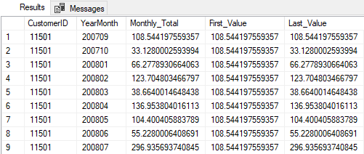
The results set
Wait what !!!!! Last_Value?????????

Slide 57


Slide 58


Slide 59
Change this
, LAST_VALUE([Step2].[Monthly_Total])
OVER (PARTITION BY [Step2].[CustomerID]
ORDER BY [Step2].[YearMonth]) AS [Last_Value]
To this
, LAST_VALUE([Step2].[Monthly_Total])
OVER ( ORDER BY [Step2].[YearMonth]
ROWS BETWEEN UNBOUNDED PRECEDING
AND UNBOUNDED FOLLOWING) AS [Last_Value]

Slide 60
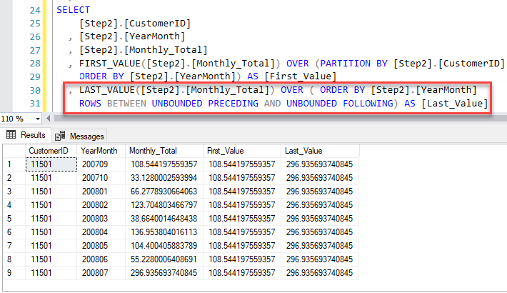
Results Set

Slide 61


